Slide 1
Machine Learning
Linear Models

Slide 2
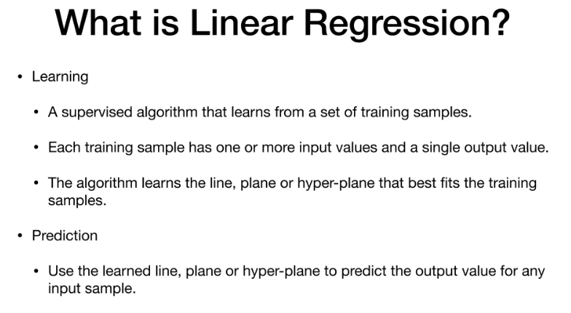
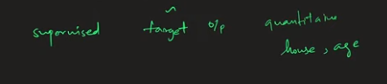

Slide 3

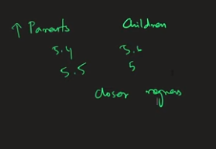
Given by

Slide 4
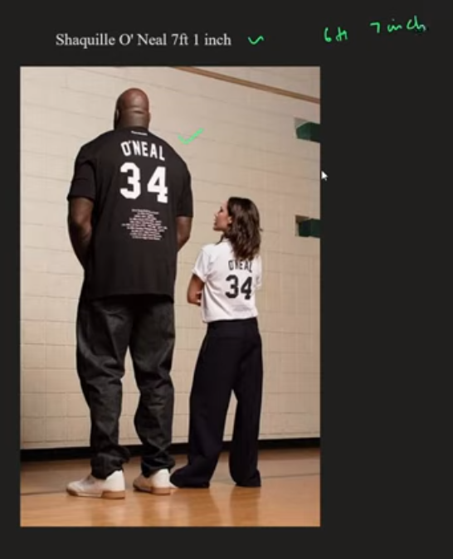

Slide 5
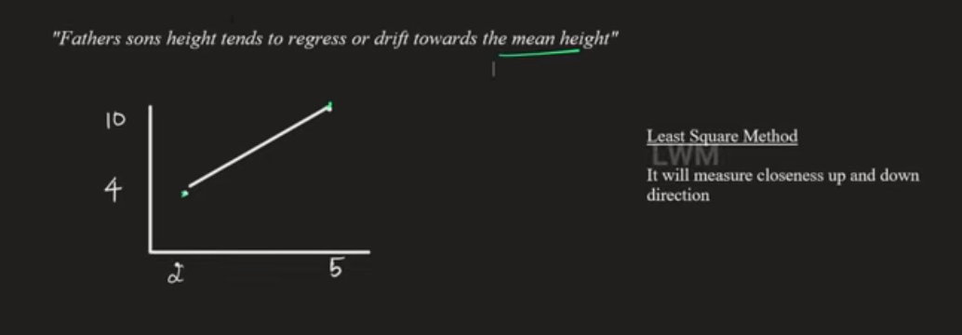

Slide 6
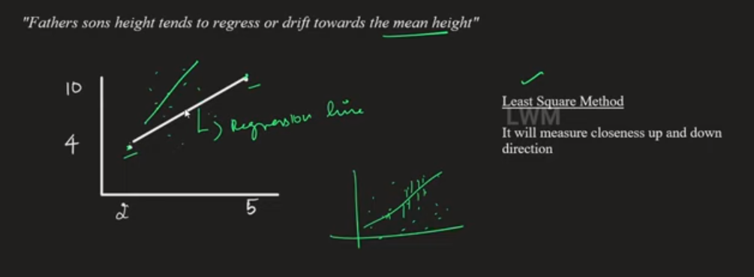

Slide 7
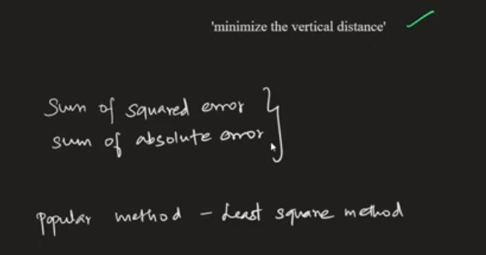
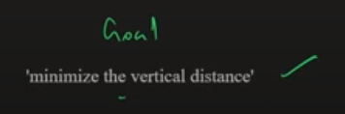

Slide 8
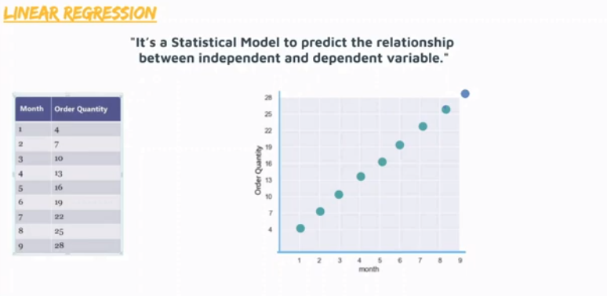
Simple Linear Regression

Slide 9
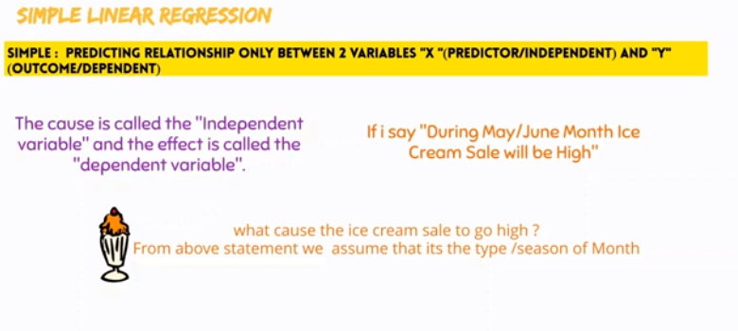
Simple Linear Regression
Only 2 variables: Between Month and Quantity sold

Slide 10
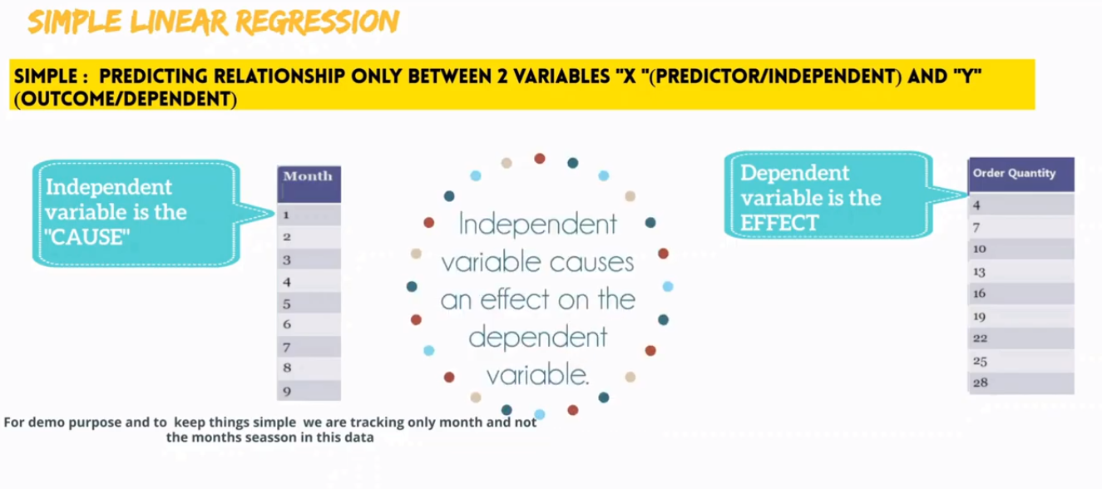
Simple Linear Regression
Month is CAUSING an effect on the number of Orders that we received.
Eg. Month is summer/Wedding month/Vacation month/Festival month
With orders, month can not be identified whereas orders can be predicted with month

Slide 11
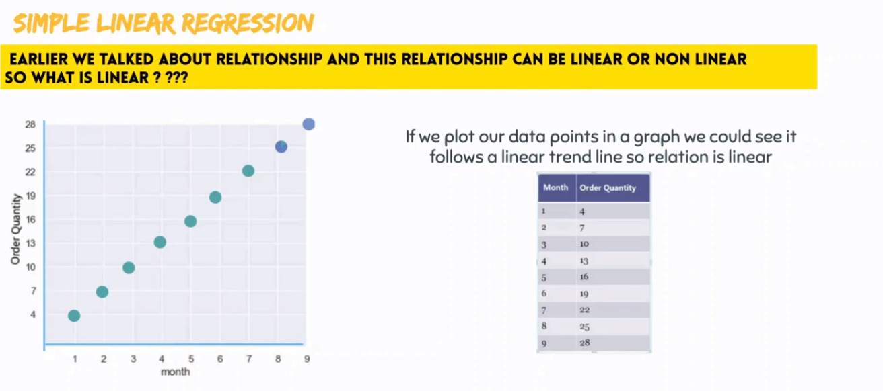
Linear or Non Linear
When independent variable increases, then dependent variable is also increased

Slide 12
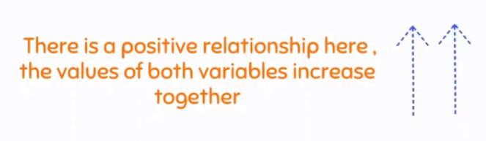
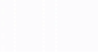
Linear or Non Linear
When independent variable increases, then dependent variable is also increased

Slide 13
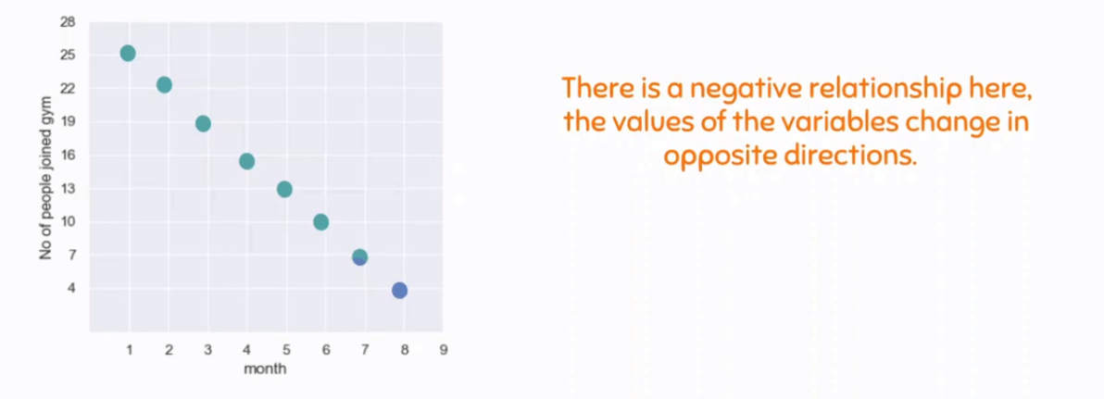
Linear or Non Linear
When independent variable increases, then dependent variable is decreased

Slide 14
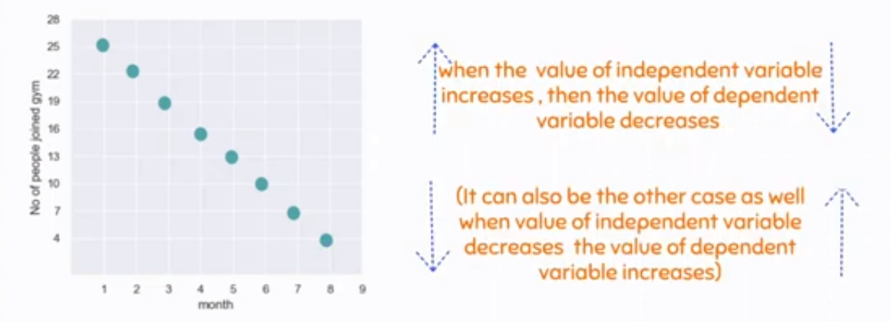
Linear or Non Linear
When independent variable increases, then dependent variable is decreased

Slide 15
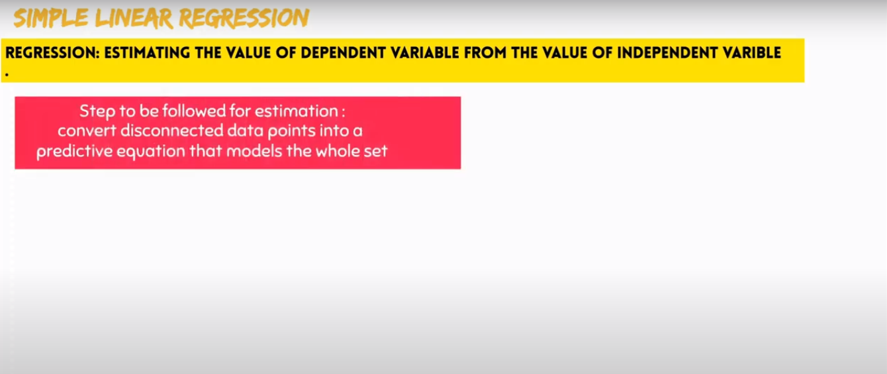
Regression

Slide 16
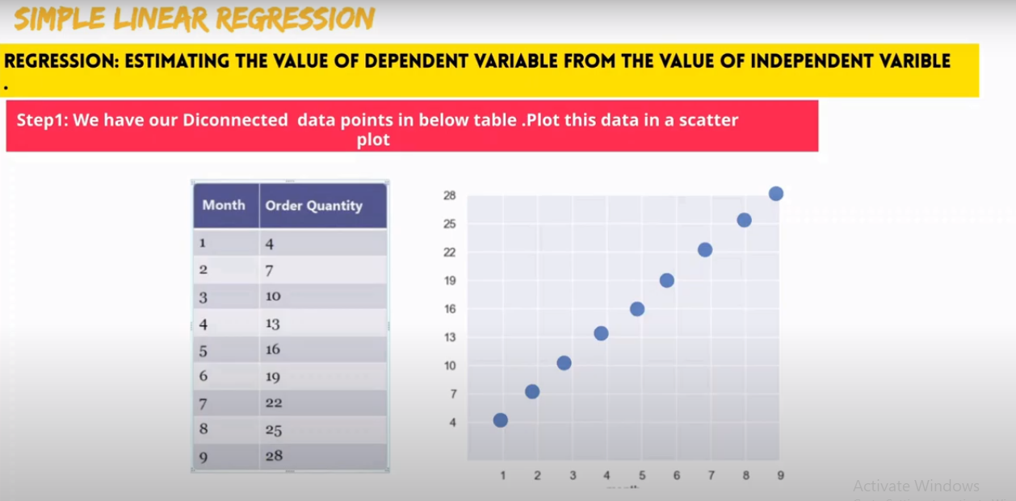
Regression

Slide 17
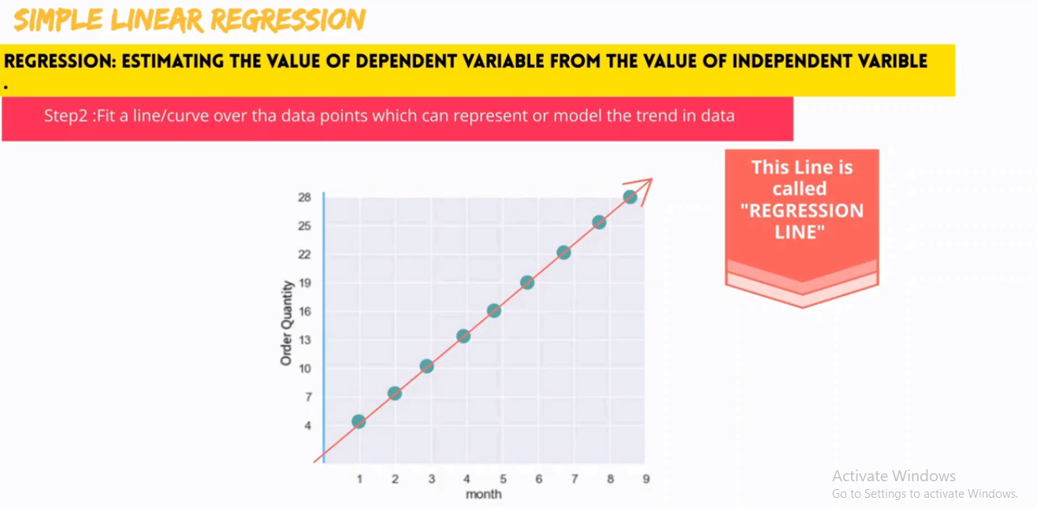
Regression

Slide 18
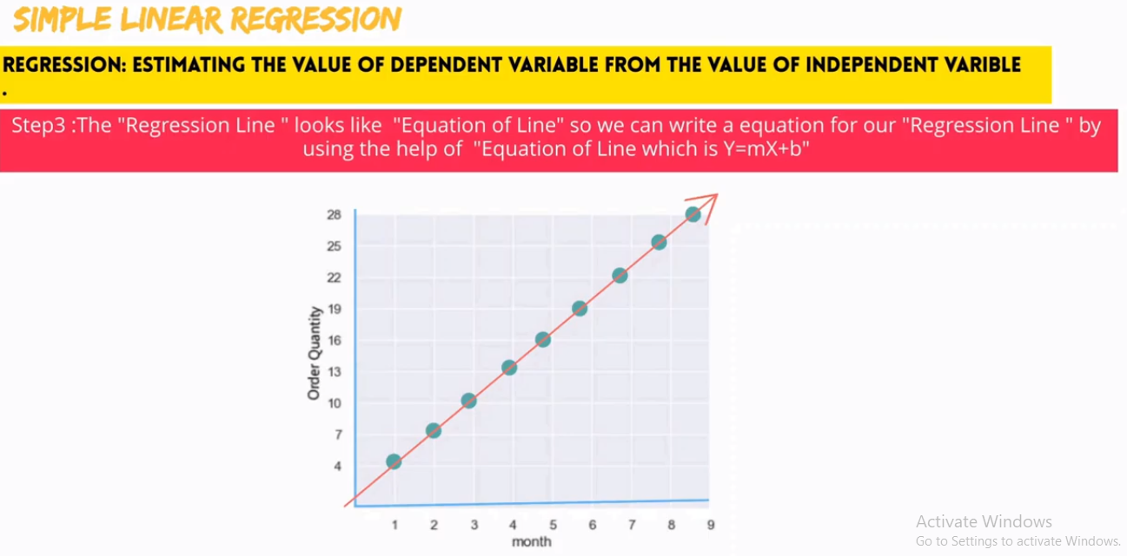
Regression
How to represent regression line using equation
Also, how to perform the PREDICTION using the same equation

Slide 19
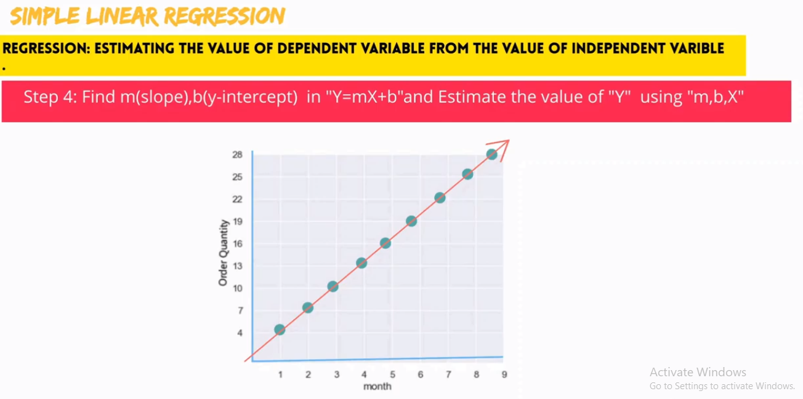
Regression
How to represent regression line using equation
Also, how to perform the PREDICTION using the same equation
Where m is slope, x refers to month and y refers to order quantity
With m, x and y values, we could predict the ORDER quantity

Slide 20
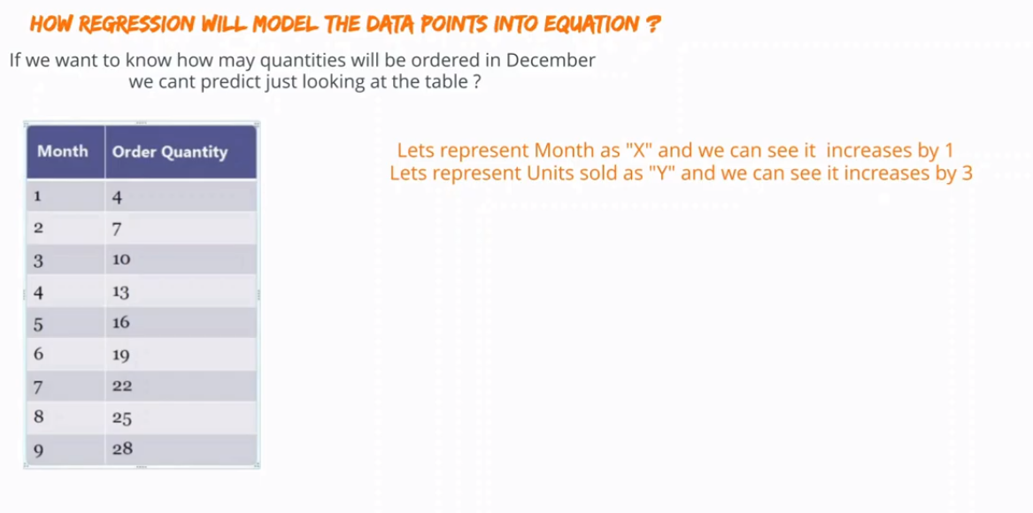
Regression

Slide 21
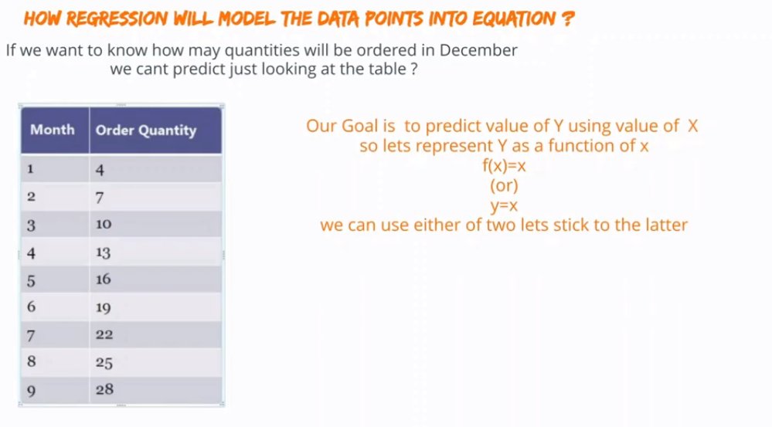
Regression

Slide 22
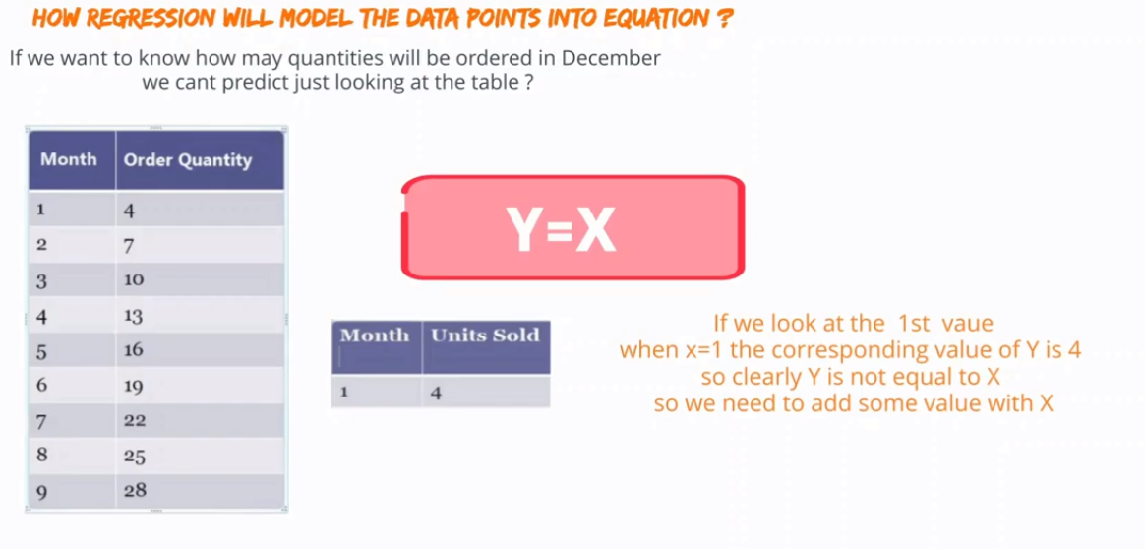
Regression

Slide 23
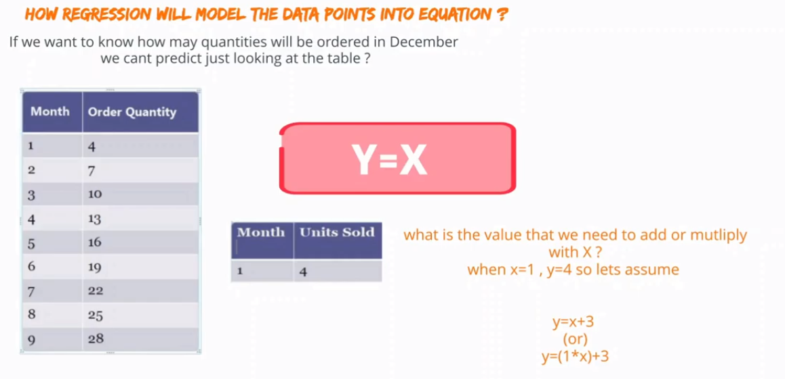
Regression

Slide 24
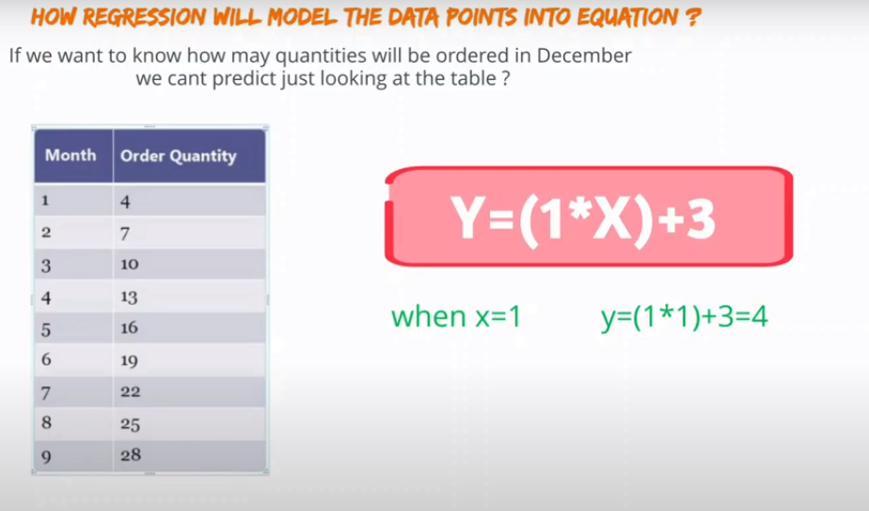
Regression

Slide 25
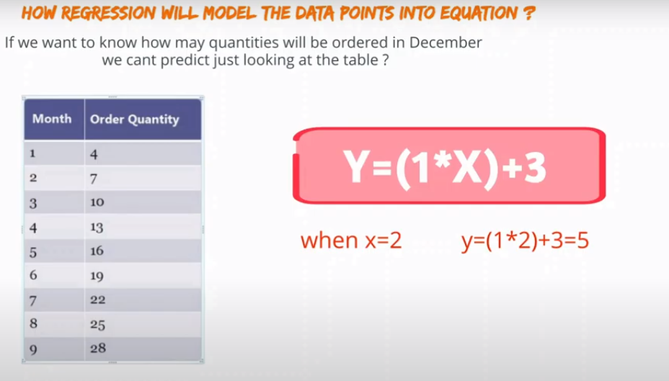
Regression

Slide 26
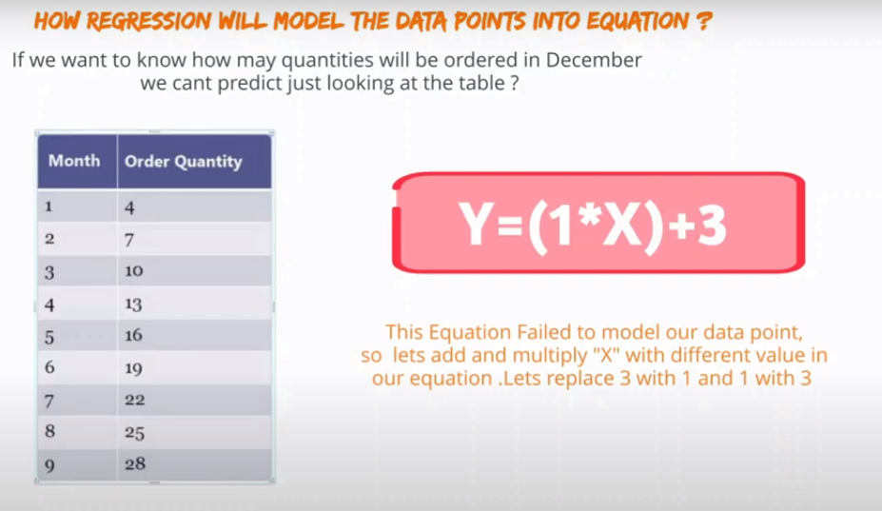
Regression

Slide 27
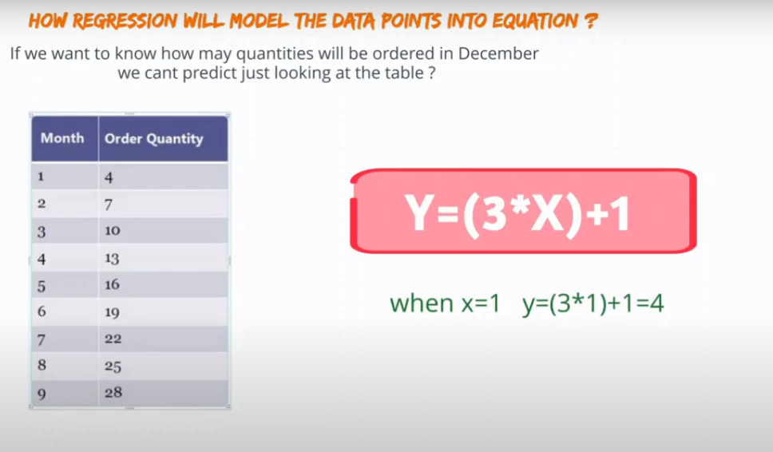
Regression

Slide 28
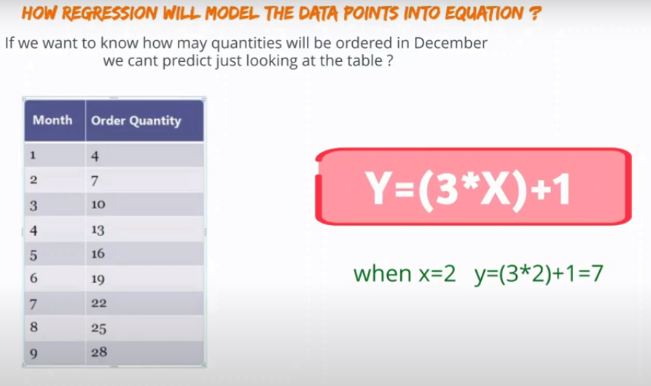
Regression

Slide 29
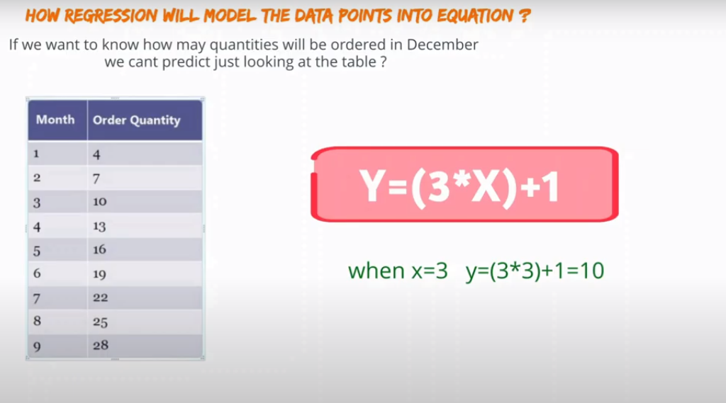
Regression

Slide 30
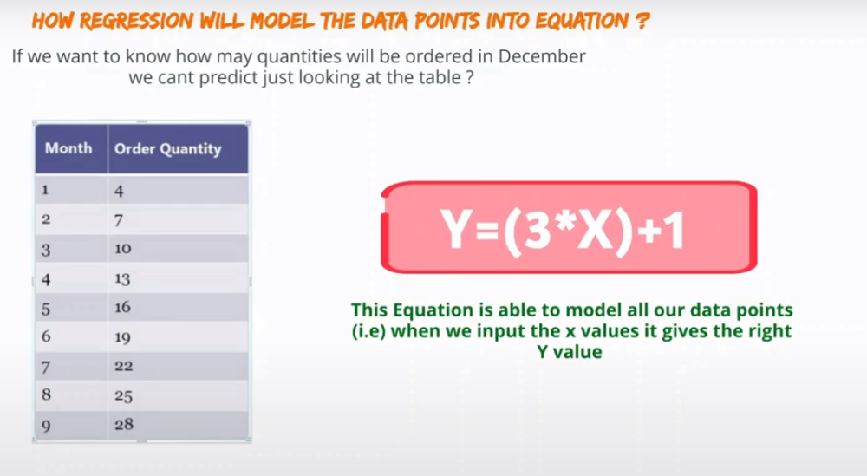
Regression
How to identify the equation?
Need to multiply the right number (3) and add the right number (1) in the last part
Hence, we can do the PREDICTION using this same equation

Slide 31
Regression
Now, this equation is REGRESSION LINE.
Regression line passes through all data points
In the equation, 3 is slope and 1 is y intercept.
By finding slope and y intercept correctly, we could identify the trend rightly

Slide 32
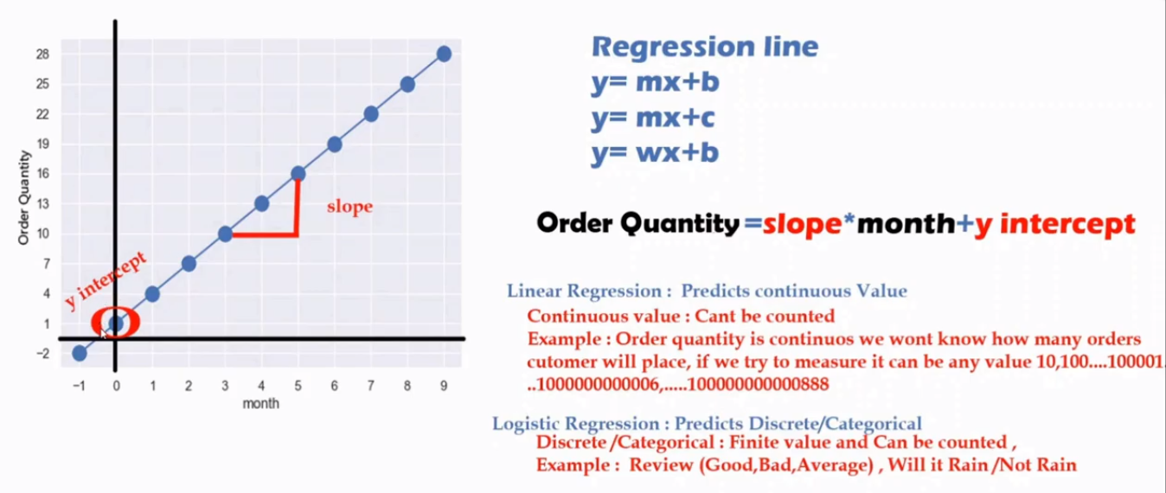
Regression
When X increases by 1 unit, slope tells the no. of units raised at Y axis
Regression Line (blue line) meets at Y axis - y intercept = meets at 1 in Y axis

Slide 33
Regression
Linear Regression – can predict only the CONTINUOUS value
i.e. we can not list all possible users access our shop for orders (i.e. it can be 1, or 10, 1000 …)
So to predict this prediction, use LINEAR REGRESSION

Slide 34
Regression
Logistic Regression – predicts the Discrete values (Anything that is countable)
If we list all discrete values (1,2,3…10), we can bring them into a RANGE.
Eg. Query: how many siblings u have? Ans: 4 or 5 (countable, where range can be defined as 1 to 10)

Slide 35
Regression
Logistic Regression – predicts the Categorical values (Anything that is countable)
If we list all categorical values (eg. 1000 Reviews: are made into 3 groups as Good, bad, avg), then learn it accordingly.
Having this knowledge, predict any future review as Good, bad or avg

Slide 36
Summary
Learnt about the Regression
Learnt how a regression identifies the trend in given data using REGESSION LINE
Learnt how a regression line can be represented as line equation
In Equation, Y should always be in LEFT and X be in RIGHT
Slope is multiplied with x and add Y-intercept in the last part of the equation
With Right values of slope and Y-intercept, it can identify the trend in given data
With the identification of trend correctly, prediction is done correctly

Slide 37
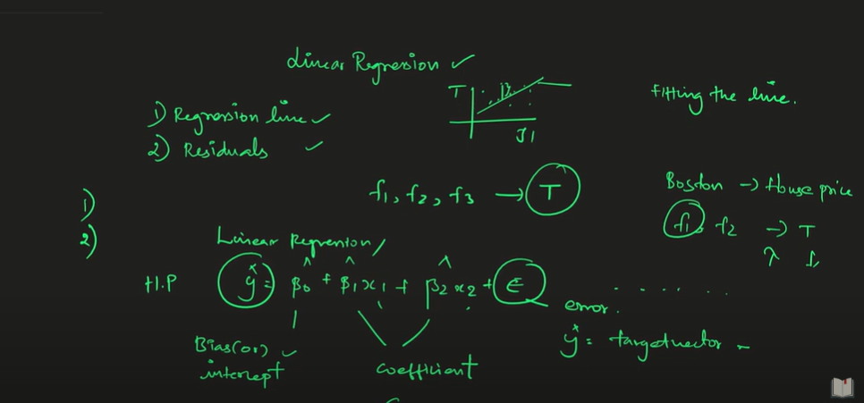
Multiple features - Equation

Slide 38
Single Dimension Linear Regression

Slide 39
Linear regression
Line is created by the equation y = a + bx
– where b is the slope of the line, and a is the intercept i.e. where the line cuts the y axis.
●
Suppose we have a dataset which is strongly correlated and so exhibits a linear relationship, how would we draw a line through this data so that it fits all points best?
●
We use the principle of least squares, draw a line through the dataset so that the sum of squares of the deviations of all points from the line is minimised.
●

Slide 40
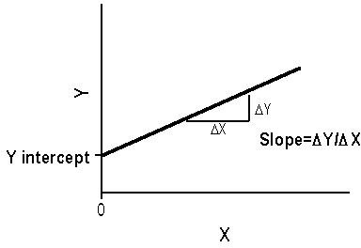
Linear regression – slope(b), a

Slide 41
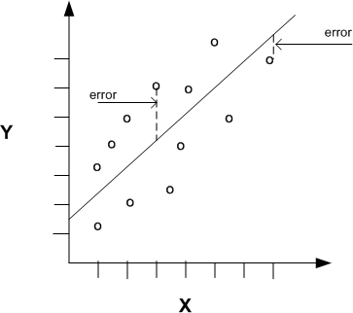
Linear regression – error

Slide 42
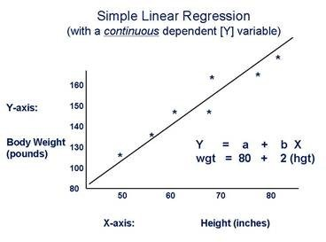
Linear regression: Y'=a+bX

Slide 43
Linear regression
For each point in the dataset, y­(a+bx) measures the vertical deviation (vertical distance) from the point to the line.
●
●
For points above the line, y­(a+bx)will be positive.
For points below the line, y­(a+bx)will be negative. Square these deviations to make them all positive.
●
●
Calculate [y­(a+bx)]² for each point (x,y), and add them up, we get the sum of the squared distances of all the points from the line.
●

Slide 44
Linear regression
Linear regression uses the fact that there is a statistically significant correlation between two variables to allow you to make predictions about one variable based on your knowledge of the other.
The line which minimises this sum of squared distances is the line which fits the data best and we call it Least Squares Line.
●
●
What is Linear Regression, what does it tell you?
●
For linear regression to work there needs to be a linear relationship between the variables.
●

Slide 45
Linear regression
A simple linear regression, predict scores on one variable from the scores on a second variable.
●
The variable we are predicting is called the criterion variable and is referred to as Y.
●
The variable we are basing our predictions on is called the predictor variable and is referred to as X.
●
When there is only one predictor variable, the prediction method is called simple regression.
●

Slide 46
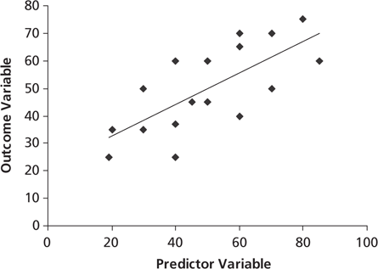
Linear regression

Slide 47
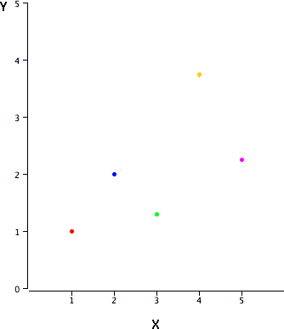
Linear regression – Ex:1
In simple linear regression, the predictions of Y when plotted as a function of X form a straight line.
Table 1. Sample data.
●
X | Y
1.00 | 1.00
2.00 | 2.00
3.00 | 1.30
4.00 | 3.75
5.00 | 2.25

Slide 48
Linear regression – Ex:1
The formula for a regression line is Y' = bX + A
where Y' is the predicted score, b is the slope of the line, and A is the Y intercept.
The equation for the line in Figure 2 is Y' = 0.425X + 0.785 For X = 1, Y' = (0.425)(1) + 0.785 = 1.21.
For X = 2, Y' = (0.425)(2) + 0.785 = 1.64.
For X = 3, Y' = (0.425)(3) + 0.785 = 2.06.
…....
●
●
●
●
●

Slide 49
Linear regression – Ex:1
The error of prediction for a point is the value of the point minus the predicted value (the value on the line).
●
Table 2 shows the predicted values (Y') and the errors of prediction (Y-Y').
●
X | Y | Y' | Y-Y' | sqr(Y-Y')
1.00 | 1.00 | 1.210 | -0.210 | 0.044
2.00 | 2.00 | 1.635 | 0.365 | 0.133
3.00 | 1.30 | 2.060 | -0.760 | 0.578
4.00 | 3.75 | 2.485 | 1.265 | 1.600
5.00 | 2.25 | 2.910 | -0.660 | 0.436
best-fitting line is the line that minimizes the sum of the squared errors of prediction

Slide 50
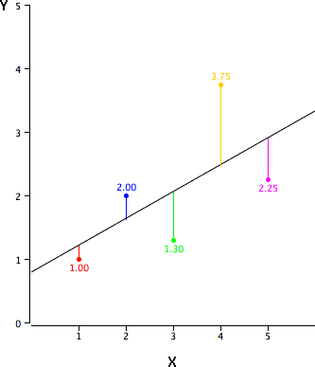
Linear regression – Ex:1
The black diagonal line is the regression line and consists of the predicted score on Y for each possible value of X.
The red point is very near the regression line; its error of predic- tion is small.
Yellow point is much higher
than the regression line; its error of prediction is large.
●
●
●

Slide 51
Linear regression – Ex:1
MX is the mean of X, MY is the mean of Y, sX is the standard deviation of X, sY is the standard deviation of Y, and r is the correlation between X and Y.
●
●
Table 3. Statistics for computing the regression line.
MX MY sX sY r
3 2.06 1.581 1.072 0.627
●
The slope (b) can be calculated as follows: b = r sY/sX
●
and the intercept (A) can be calculated as A = MY – b MX
●
b = (0.627)(1.072)/1.581 = 0.425
●
A = 2.06 - (0.425)(3) = 0.785

Slide 52
Linear regression – Ex:2
House Price in $1000s Square Feet (Y) (X)
245 | 1400
312 | 1600
279 | 1700
308 | 1875
199 | 1100
219 | 1550
405 | 2350
324 | 2450
319 | 1425
255 | 1700

Slide 53
House Price: Scatter plot
450
400
350
300
250
200
150
100
50
0
House Price ($1000s)
0
500 1000 1500 2000 2500 3000
Square Feet

Slide 54
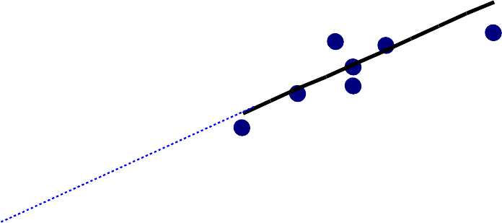
House Price: Linear regression
450
400
350
300
250
200
150
100
50
0
House Price ($1000s)
Slope
= 0.10977
Intercept
= 98.248
0
500 1000 1500 2000 2500 3000
Square Feet
house price = 98.24833 + 0.10977 (square feet)

Slide 55
House Price: Linear regression
Predict the price for a house with 2000 square feet:
house price = 98.25 + 0.1098 (sq.ft.)
= 98.25 + 0.1098(2000)
= 317.85
The predicted price for a house with 2000 square feet is 317.85($1,000s) = $317,850

Slide 56
Outliers
After a regression line has been computed for a group of data, a point which lies far from the line (and thus has a large residual value) is known as an outlier.
●
Such points may represent erroneous data, or may indicate a poorly fitting regression line.
●
These points have may have a significant impact on the slope of the regression line.
●
Depending on their location may have a major impact on the regression line.
●

Slide 57
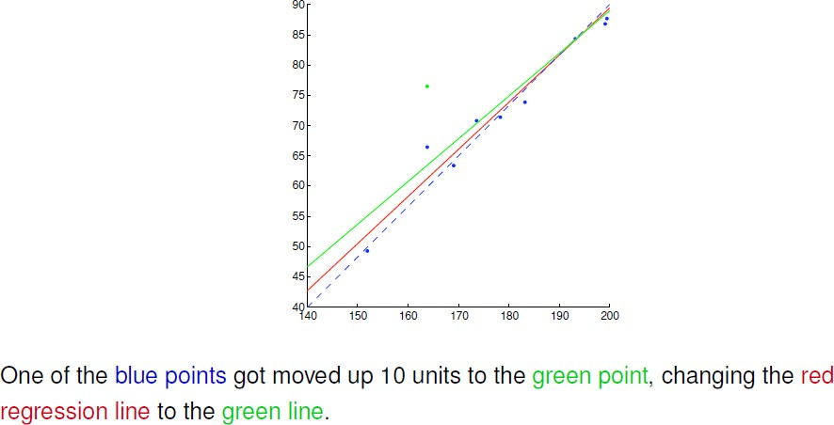
Outliers

Slide 58
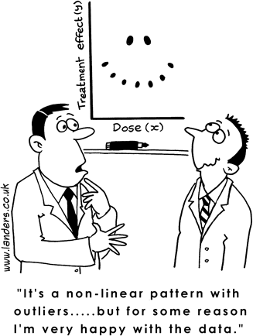
Summary
●
...

